Slide 1
International Portfolio Diversification
Majed Boukli Hasan- 100983265
Matthew Dickey- 100945781
Hussam Hammad- 100986708

Slide 2
Agenda
Introduction
Notable literature Review
Our Hypothesis
Data & Methodology
Findings
Conclusion
Limitations
Notes:
Dickey

Slide 3
What is International Diversification?
The arguments for global portfolio diversification are - as laid out in the mid-1970s - centered on portfolio risk or increasing portfolio expected return relative to a comparable domestic portfolio. (Micahua et al., 1996)
Notes:
Dickey

Slide 4
Motivation & Objectives
Motivation
Objective
Lack of updated literature surrounding the effects of new technologies on international diversification
The main factor being the internet
In depth research into how new technologies have changed the way we invest
Discover whether international diversification is still an optimal investing strategy
Notes:
Dickey

Slide 5
Literature Review
Dua & Tuteja (2016)
Looking to investigate the contagion that has spread across stock and currency markets of China, Eurozone, India, Japan and US during global financial crisis.
The used the DCC-GARCH model to estimate the time-varying conditional correlation coefficients among asset market returns.
They were able to find is in times of financial stress the benefits of portfolio diversification that investors rely on actually may be non-existent.
Zhang, Zheng & Zeng (2016)
Wanted to examine the dynamic interdependence of international markets.
Hypothesis based around the theory that turbulence in one market can cause a disturbance in another.
Main findings were than American indices have a strong effect on other indices around the world. (when they struggle other do)
Kiani (2011)
Looked to see the true effects of local and international portfolio diversification affected risk
He found that overall international diversification did reduce the investors exposure to risk.
Notes:
Dickey
Garch model → Dynamic Conditional Correlation

Slide 6
Literature Review
Coeurdacier & Guibaud (2010)
Utilizing aggregate data on equity holdings in order to investigate whether investors correctly hedge their over-exposure to domestic risk
Study revolves around the rational portfolio theory to describe investors asset allocation decisions.
Familiarity is the most crucial factor in selecting your portfolio and those who invest internationally do so properly
Kim et al. (2017)
They propose that the risk in a portfolio is made from three components; variance, skewness and kurtosis
Overall they are able to show that diversification is able to reduces risk but only when a portfolio is well-diversified. Which means only investors that are well educated can reduce their risks.

Slide 7
Our Hypothesis
Ho: The benefits of international diversification will be significantly less than previously reported.
Ha: International diversification serves its goals as optimizing the portfolio.
Notes:
Majd

Slide 8
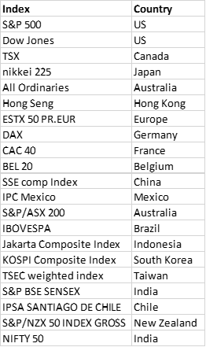
Data & Methodology
Panel 1:
Sample period
January 1980 - December 2017
Broken into 4 periods
Indices correlations
Notes:
Majd and Hussam

Slide 9
Data & Methodology
Portfolio | Domestic (US) | International
A | 100% | 0%
B | 50% | 50%
C | 0% | 100%
F | Interlisted (cross-listed) companies
G | Mix of International indices - Using Country weighted GDP (including US) - Benchmark
Z | Mix of International indices - Using Country weighted GDP (excluding US)
Panel 2:
Same period of study
7 Portfolios
Analyze the changes over time
Assessment factors:
Beta against benchmark & S&P 500 (portfolios A & G)
Variance, Sharpe ratio, Information ratio
Notes:
Majd and Hussam

Slide 10
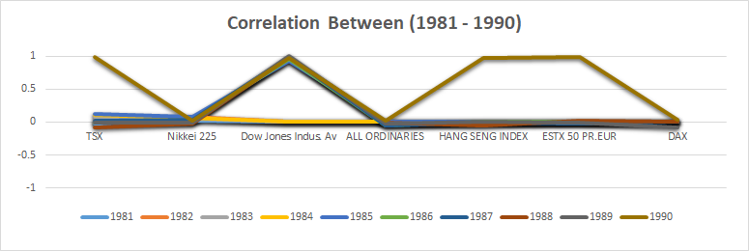
Findings
Panel 1: Period 1
Notes:
Hussam

Slide 11
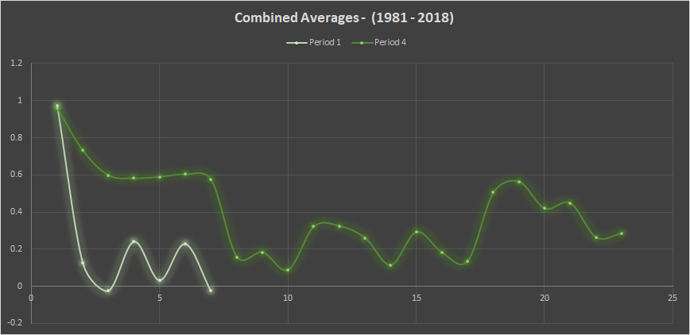
Findings
Panel 1: Period 1 vs Period 4 - Average
Notes:
Hussam

Slide 12
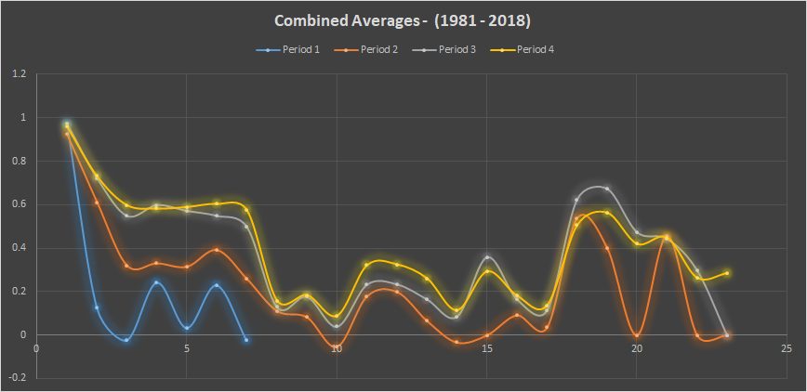
Findings
Panel 1: Period 1 Through Period 4 - Average
Notes:
Hussam

Slide 13
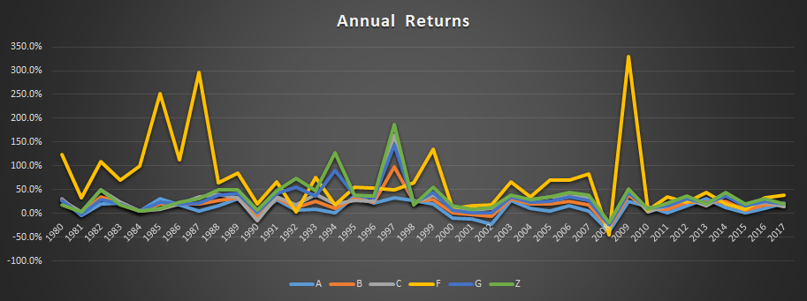
Findings
Panel 2: Period 1 through Period 4 Returns
Notes:
Hussam

Slide 14
Findings
Panel 2: Period 1 through Period 4 Beta (B) against S&P 500
Portfolio | (1980-1990) | (1991-2000) | (2001-2010) | (2011-2017) | Aggregate
A | 1.00 | 1.00 | 1.00 | 1.00 | 1.00
B | 0.62 | 0.66 | 0.74 | 0.76 | 0.65
C | 0.24 | 0.32 | 0.48 | 0.52 | 0.29
F | 0.66 | 0.56 | 0.92 | 1.05 | 0.82
G | 0.34 | 0.51 | 0.64 | 0.69 | 0.55
Z | 0.08 | 0.31 | 0.48 | 0.64 | 0.37
Notes:
Hussam

Slide 15
Findings
Panel 2: Period 1 through Period 4 Beta (B) against Global index (Portfolio G)
Portfolio | (1980-1990) | (1991-2000) | (2001-2010) | (2011-2017) | Aggregate
A | 2.40 | 0.93 | 1.15 | 1.04 | 1.16
B | 1.59 | 1.00 | 1.03 | 1.00 | 1.05
C | 0.78 | 1.06 | 0.91 | 0.97 | 0.93
F | 2.02 | 0.89 | 1.31 | 1.33 | 1.26
G | 1.00 | 1.00 | 1.00 | 1.00 | 1.00
Z | 0.50 | 1.07 | 1.03 | 1.07 | 1.26
Notes:
Hussam

Slide 16
Findings
Panel 2: Period 1 through Period 4 Information Ratio
Info Ratio | (1980-1990) | (1991-2000) | (2001-2010) | (2011-2017) | Aggregate
A | -0.376 | -2.383 | -0.936 | -0.988 | -1.107
B | -0.590 | -3.986 | -1.051 | -1.474 | -1.707
C | -0.094 | -1.243 | 0.282 | -0.268 | -0.276
F | 2.019 | 0.144 | 1.697 | 0.340 | 1.239
G | Benchmark
Z | 0.579 | 2.240 | 1.131 | 0.894 | 1.163
Notes:
Hussam

Slide 17
Findings
Panel 2: Period 1 through Period 4 Sharpe Ratio
Sharpe Ratio | (1980-1990) | (1991-2000) | (2001-2010) | (2011-2017) | Aggregate
A | 0.281 | 0.676 | -0.107 | 0.668 | 0.314
B | 0.604 | 1.499 | 0.314 | 0.995 | 0.771
C | 0.774 | 1.900 | 0.706 | 1.106 | 1.022
F | 3.412 | 2.719 | 1.488 | 1.196 | 2.101
G | 0.829 | 2.837 | 0.600 | 1.339 | 1.247
Z | 1.074 | 3.233 | 0.860 | 1.410 | 1.451
Notes:
Hussam

Slide 18
Limitations
Selection of securities in Portfolio F
Passive vs. Active in Portfolio A
Currencies exposure (floating vs. controlled)
Reoccuring organizations in multiple indices
Notes:
Majd

Slide 19

Conclusion
What should you do as portfolio manager ?
How to cope with these results? And how to apply a protection strategy against the increase of correlation?
LASTLY, there is no right solution
Thank you for listening
Go make money !
Notes:
Hussam

